Slide 1
Housing Prices Prediction
EDUBRIDGE PROJECT
Guided By:
Prabhjot Singh
Submitted By:
Anandha Lakshmi I
Bhuvaneshwari G
Tathagata Adhikari

Slide 2
Introduction
In this project, using machine learning model will predict the house price of an Indian city.
This project will be very helpful for the real estate market.
This model can be used by both house sellers and house buyers.
Linear regression algorithm is a basic and commonly used type of predictive analysis.
These regression estimates are used to explain the relationship between one dependent variable and one or more independent variables.

Slide 3
Problem Statement
People having budget for buying home are unable to buy because of the difference in prices provided by agent and also difficult for them to calculate the affecting parameters required in estimating the rate of property.
Manual knowledge makes person confused since data may vary person to person.
In order to eradicate such issues an automated model using Linear Regression is implemented to provide efficient outcome as per user requirement.

Slide 4
Tools and Technology Used
Anaconda ( Jupyter Lab/Notebook )
Python 3 – Programming Language
Libraries:
NumPy
Pandas
Matplotlib.pyplot
Seaborn
Sklearn.linear_model import LinearRegression
Sklearn.model_selection import train_test_split
Sklearn.metrics import classification_report
Sklearn.metrics import confusion_matrix

Slide 5
How it works
Data Collection
Data Cleaning
And Preprocessing
Feature Selection
Training the Model
Feature Scaling
Splitting the Data
Prediction

Slide 6
Linear Regression
Linear regression is a statistical method that is used to predict a continuous dependent variable (target variable) based on one or more independent variables (Features).
This technique assumes a linear relationship between the dependent and independent variables.
When the number of the independent feature, is one then it is known as Univariate Linear regression, and in the case of more than one feature, it is known as multivariate linear regression.

Slide 7
Future Scope
System includes set of codes that processes on the available dataset to effectively predict the value of outcome depending upon user input using the concept of Linear Regression.
Proper usage of model is beneficial to both the customer as well as agents guiding customers.
It is important to note that these are only predictions based on current trends and assumptions.
They may change depending on various factors such as economic fluctuations, political events, natural disasters etc., that may affect the real estate market in unexpected ways.

Slide 8
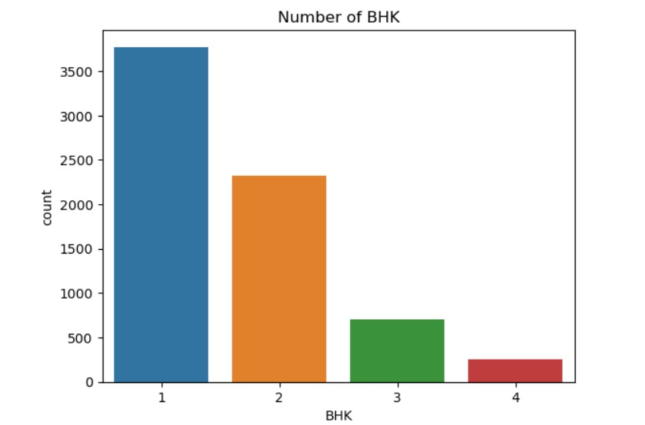
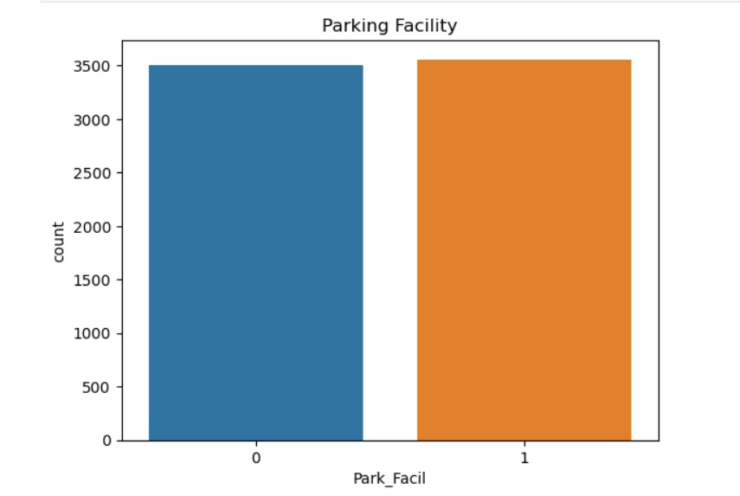
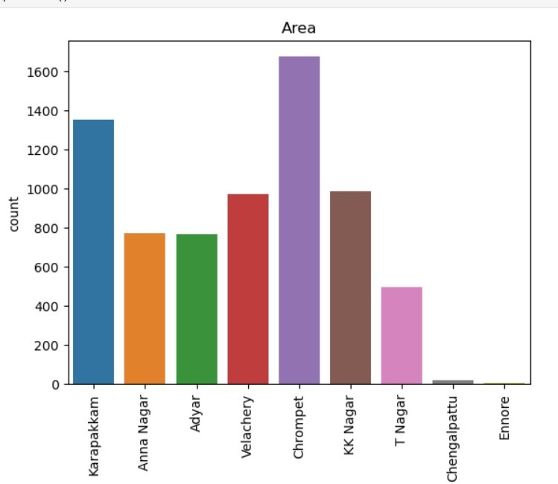
Univariate

Slide 9
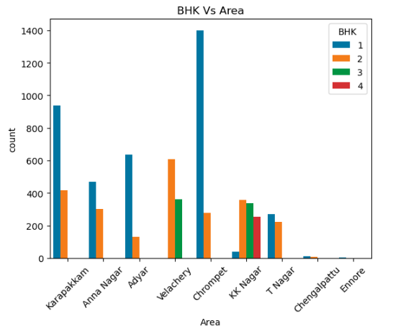
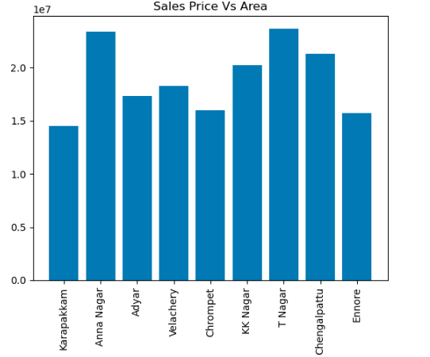
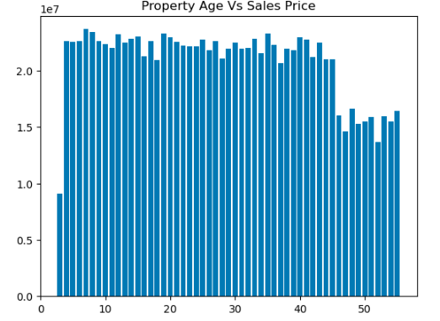
Bivariate

Slide 10
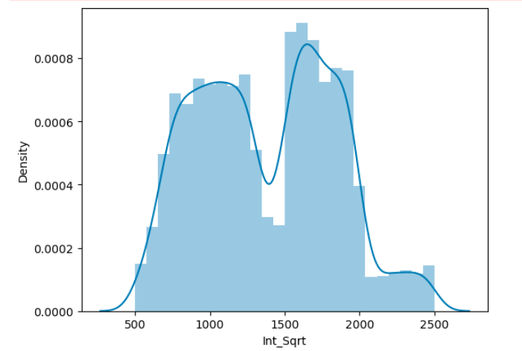
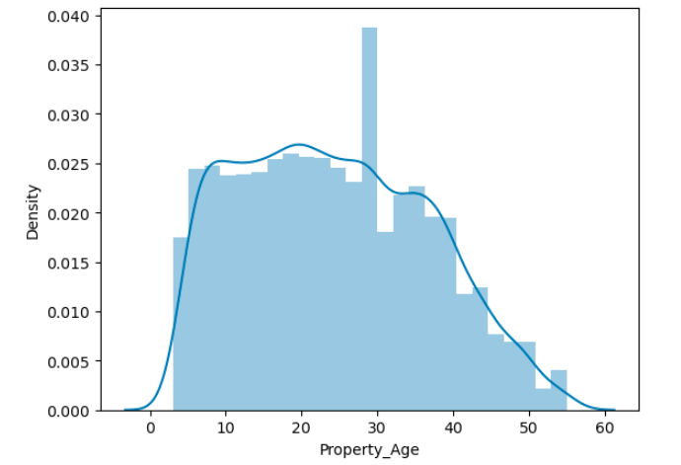
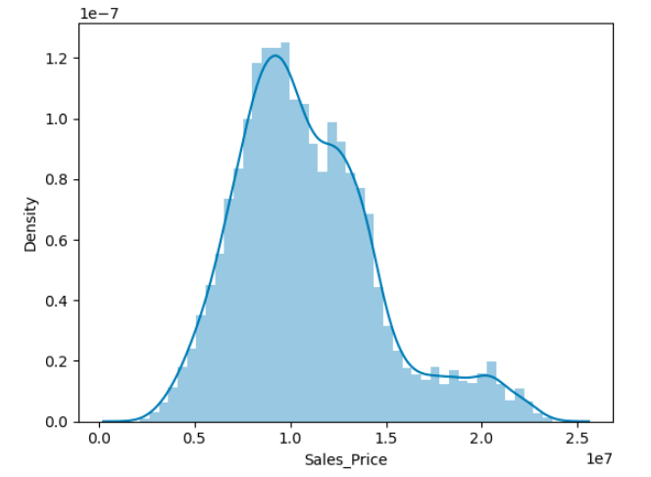
Distance Plot

Slide 11
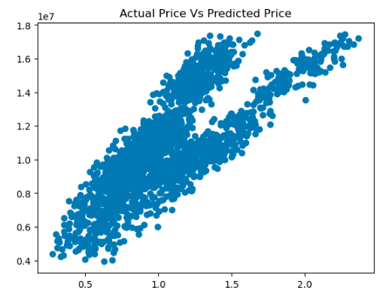

Slide 12
Conclusion
Thus, we studied and applied the concept of Linear Regression in real time implementation.
Dataset provide us with complete data about the surrounding.
This helps to get the insight of the surrounding and machine learning model helps to predict the price of the property based on the training provided by the dataset.
We successfully implemented linear regression model to predict the price of the houses.

Slide 13
Thank You

